Slide 1
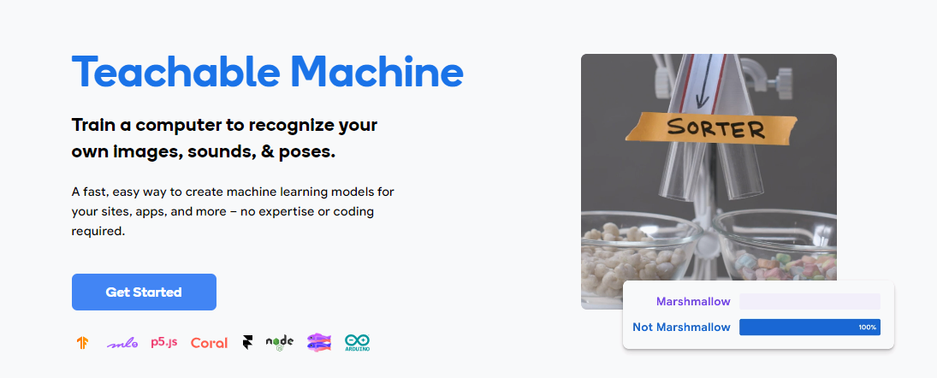
Make Your Own Image Classifier
Student Activity

Slide 2


Slide 3
Try It: Thumbs up vs Peace sign Classifier
Goal: Train a classifier to identify peace sign, thumbs up, or neither of these
Step 1: Open teachable machine - https://teachablemachine.withgoogle.com/
Step 2: Watch the Getting Started video (scroll down on the page for video).
Step 3: Create a peace sign class, and train it with peace sign gestures
Step 4: Create a thumbs up class, and train it with thumbs up gestures
Step 5: Create a none of the above class, and train it with no hand gestures or no peace or thumbs up sign
Step 6: Build model,
Step 7: Test out model yourself and improve it
Step 8: Then have a friend test your model and improve it

Slide 4
How to Improve your Classifier
Reflection
How well does your classifier do? Does it classify the input correctly?
If your model doesn’t classify your test input correctly, check to see if you have any of the following issues
All your training images look the same: not enough variation
Not enough images (less than 30)
The test images don’t look like the training images: training set is not representative of the test set
You don’t have a null (“none of the above”) class where no gesture is being made
The differences between the two classes are very subtle

Slide 5
The Teachable Machine Pipeline
In Module 3.1, we used Code.org’s AI lab to create a dataset and trained a visual classifier for peace sign vs thumbs up
Build Dataset
Test
Identify the question
Identify the classes (labels)
Collect your data for each class
Train a classifier
Collect test data
If accuracy low
Use the model in a system
If accuracy is high
Test the model with users
If accuracy is high
Review Accuracy
Test the model

